Slide 1

SYNOPSIS Presentation
On
Kiet e-Bazaar
by
Akanksha Dwivedi 202410116100012
Bhavna Rajput 202410116100049
Session:2025-2026 (III Semester)
Under the supervision of
Dr. Shashank Bharadwaj
Department Of Computer Applications
KIET GROUP OF INSTITUTIONS, DELHI-NCR, GHAZIABAD-201206

Slide 2
Project Overview
KIET e-Bazaar is a purpose-built digital platform aimed at facilitating seamless & secure platform for buying and selling second-hand goods among students and faculties within the KIET campus.
Our primary goal is to create a structured and accessible system for the exchange of items, addressing the current lack of a centralized marketplace.
Problem Solved
Significance
There is a lack of a secure and centralized platform dedicated for the buying and selling of goods amongst the students and faculties at KIET.
This platform gives a tailor-made mechanism to buy and sell goods with ease for its users within the KIET campus thereby fostering sustainability by encouraging reuse.
It also cultivates a vibrant, student-driven internal economy. It's more than just a marketplace; it's a community initiative.

Slide 3
Project Objectives
Facilitate Listing
Enhance Navigation
Enable students and faculties to easily list items for sale, including detailed descriptions and images.
Provide a user-friendly and intuitive UI with search and filtering capabilities for buyers to quickly find their desired items.
Create a secure Environment
Ensure User Satisfaction
Create a secure environment for the buying and selling of goods only between verified KIET students and faculties.
Provide buyers with the ability to negotiate with sellers and arrive at a mutually acceptable price ensuring maximum user satisfaction.

Slide 4
Project Scope
Inclusions
Exclusions
User authentication & signup: Secure login and registration for KIET members.
Payment gateway: Direct payment processing will not be handled by the platform in this phase; transactions will be arranged directly between users.
Item listing: Clear categorization of items in the UI and comprehensive fields for item details (name, price, condition, category).
Search & filters: Advanced options for efficient item discovery.
Request/offer system: Functionality for buyers to make offers or inquiries.

Slide 5




Methodology
We want to ensure flexibility, rapid adaptation to user needs, and efficient problem-solving throughout the project lifecycle. To that end, we will be adopting the Agile Methodology for the development of KIET e-Bazaar, enabling iterative development and continuous feedback cycles.
Frontend
Backend
React.js, HTML, CSS
Node.js, Express.js
Database
Version Control
MongoDB
GitHub

Slide 6
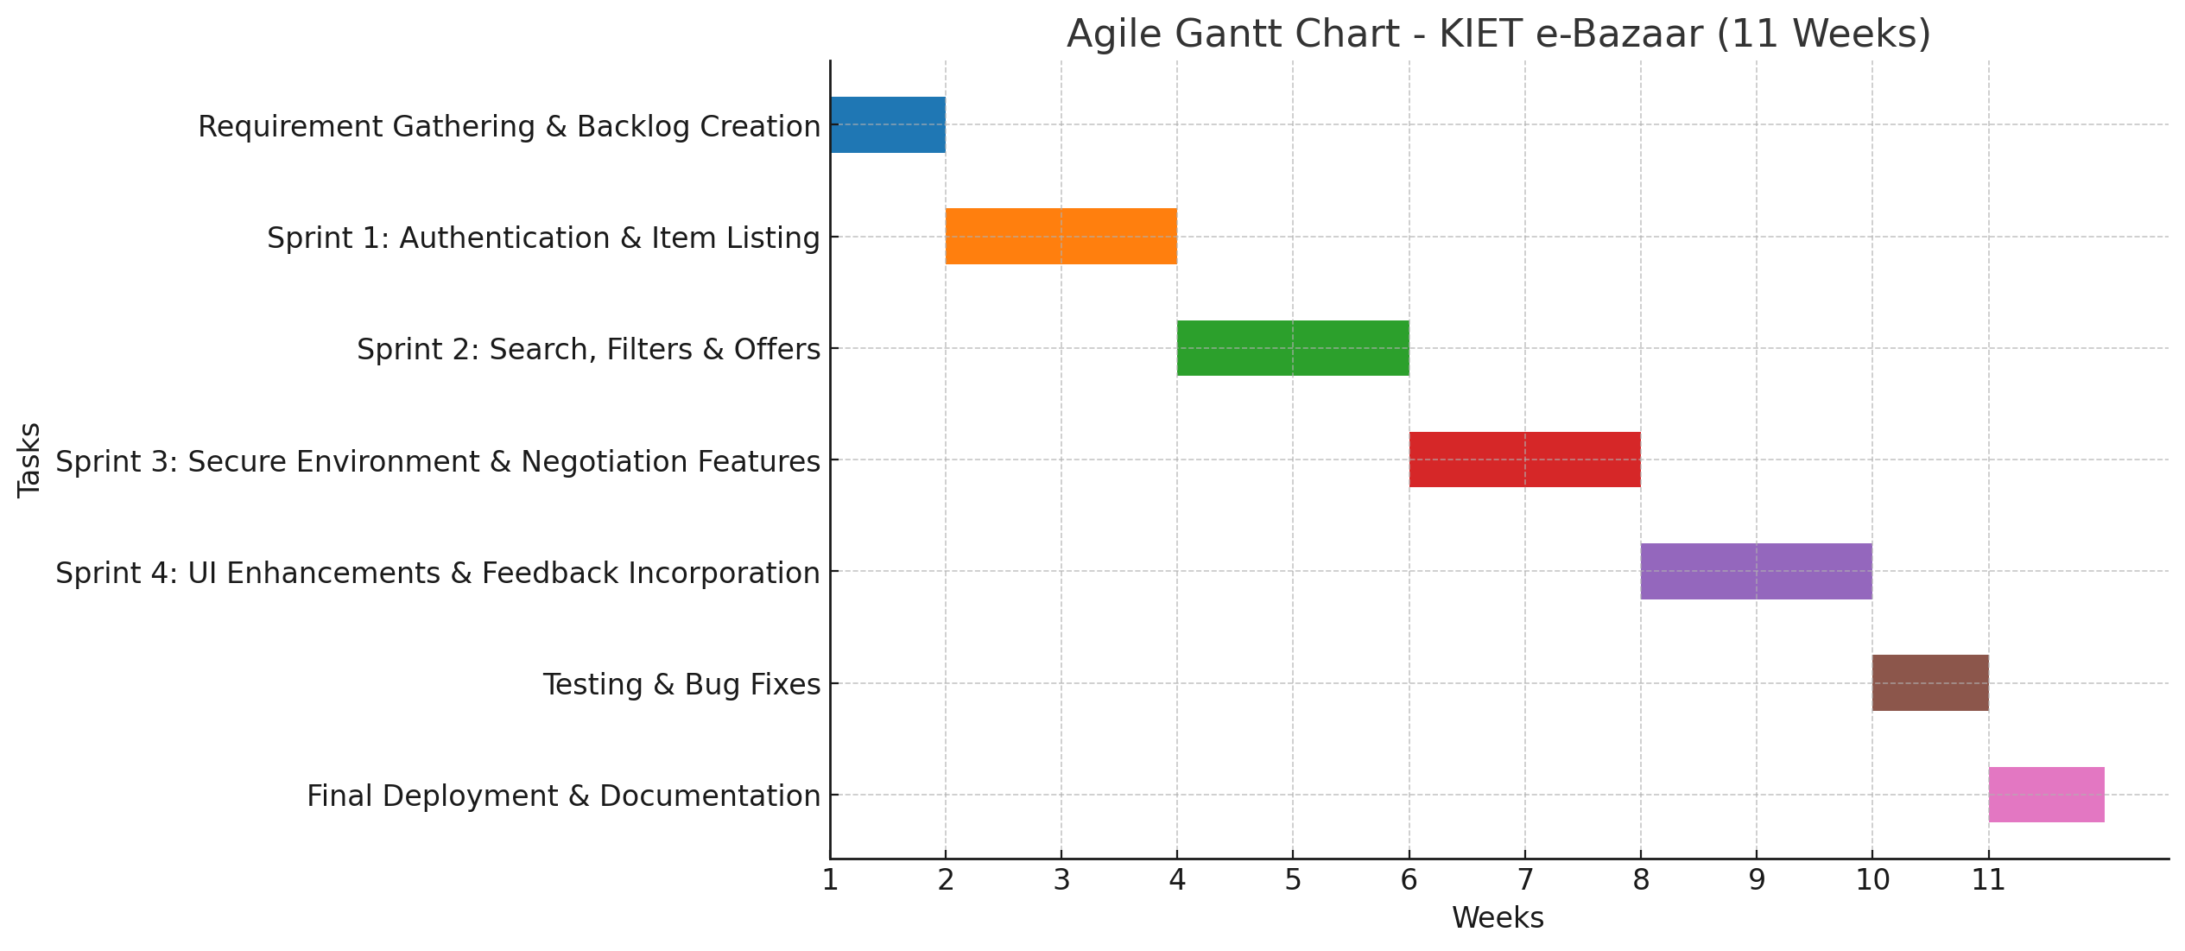
Timeline
Our project timeline is structured to ensure a systematic and efficient development process, culminating in a functional and
well-tested application. The Gantt chart below is meant to illustrate our phased approach:
This 6-week roadmap allows for focused development and timely delivery, with dedicated phases for crucial steps like testing and incorporating initial user feedback.

Slide 7

Project Outcome
Upon completion, the KIET e-Bazaar will deliver a tangible and
highly beneficial outcome for the campus community.
Functional Web Application
We will launch a fully operational web application serving as the primary marketplace for the campus, accessible from any device.
Enhanced Convenience
Users will experience unparalleled ease in buying and selling goods, saving time and effort compared to traditional methods.
The foundation laid in this phase opens doors for exciting future
enhancements, ensuring the e-Bazaar's long-term relevance and utility.

Slide 8
Future Expansion
While our initial phase is focused on core functionalities, we have thought of several exciting avenues for future expansion:
1
2
Mobile Application
Payment Integration
Developing a dedicated mobile app for both Android and iOS to enhance accessibility and user experience on the go.
Integrating secure payment gateways to streamline transactions directly within the platform, offering greater convenience and safety.
3
4
KIET Portal Integration
AI Recommendations
Seamlessly linking with the official KIET portal for improved user authentication and community access.
Implementing AI-powered recommendation systems to personalize user feeds and suggest relevant items based on browsing history and preferences.

Slide 9
Conclusion
The KIET e-Bazaar project stands as a testament to our commitment to innovation and community enrichment. We have successfully outlined and are on track to deliver a functional, convenient, and sustainable marketplace for the KIET campus.
"We are confident that KIET e-Bazaar will become an indispensable tool, fostering a stronger, more connected, and resource-efficient community at KIET."
This platform not only solves an existing problem but also lays the groundwork for a more integrated digital campus experience in the future. We are excited about the positive impact this project will have on the daily lives of students and faculty.

Slide 10

Thank You!

